Slide 1
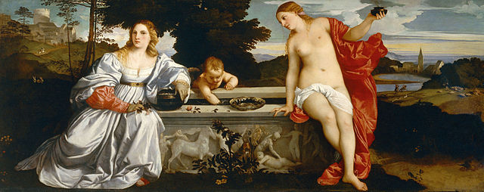
History 336
Ideas and Society in Early Modern Europe:
The Debate about Gender and Identity

Slide 2
François Poullain de la Barre: Historical Context
Seventeenth-century France
  state’s role in culture: academies
    Académie Française (1635): (p. 86)
    some academies established by Louis XIV (1643-1715): Dance (1661), Science (1666), Music (1669), Architecture (1671); (p. 59)
    “a stricter adherence to social conformity” (p. 3)

Slide 3
François Poullain de la Barre: Historical Context
Women in seventeenth-century France
  education in convent schools: Ursulines
  charitable work: Daughters of Charity (pp. 69, 70)
  Molière
    Les précieuses ridicules (1659)
    Les femmes savantes (1672) = The Learned Ladies

Slide 4
François Poullain de la Barre: Historical Context
Women in seventeenth-century France
  Marie Le Jars de Gournay (1565-1645), The Equality of Men and Women (1622)

Slide 5
François Poullain de la Barre: Historical Context
Cartesianism
  René Descartes (1596-1650)
  mechanism (p. 93)
  dualism: body and soul /mind (pp. 63, 103)
  epistemology: “clear and distinct ideas” (pp. 50, 85)
    rationalism, cogito ergo sum
  challenge to Aristotelian physics: final cause

Slide 6
François Poullain de la Barre (1647-1723)
born in Paris
studied theology for the priesthood, Sorbonne
encountered Cartesian philosophy, 1660s
ordained a priest by 1679
served in parishes 1681-1685
settled in Protestant Geneva, 1688
an unreliable Protestant (pp. 18-19)

Slide 7
François Poullain de la Barre (1647-1723)
Writings
  Equality of the Two Sexes (1673)
    reaction to Molière’s Femmes savantes (1672)?
    English translation: The Woman as Good as the Man (1677)
    Simone de Beauvoir (1908-1986), The Second Sex (1949): pp. 32-33
  Education of Women (1674)
  Excellence of Men (1675)

Slide 8
Equality of the Two Sexes
origin of the concept of women’s inferiority to men: custom / prejudice (pp. 54-55)
supremacy of reason
“It is easy to see that the difference between the two sexes is limited to the body, since that is the only part used in the reproduction of humankind. Since the mind merely gives its consent, and does so in exactly the same ways in everyone, we can conclude that it has no sex” (p. 82)

Slide 9
Equality of the Two Sexes
the mind has no sex: consequences: pp. 82-100
gender and power
  “it is a popular misonception that learning is pointless for women because they have no access to the positions which are the reason for taking up study” (p. 94)
  “public and high state office” (p. 96)
  ecclesiastical office (p. 97)
“There is absolutely no reason to think that women are not as perfect as men” (p. 104).

Slide 10
Equality of the Two Sexes
disenfranchisement of the “Ancients” (pp. 73, 76, 117), philosophers (117-20), poets and orators (73-74)

Slide 11
Equality of the Two Sexes
“God desired to produce human beings dependent upon each other through the intercourse of two people. For this purpose he created two bodies different from each other. Each was perfect in its own way: both are presently constituted as they were ordained, and all those features that characterize their specificity should be seen as an integral part of their perfection. There is absolutely no reason to think that women are not as perfect as men” (p. 104).

Slide 12
Equality of the Two Sexes
“If we want to make fun of a man for having too little courage, resolution, and firmness, we call him effeminate, as if we mean to say that he is as weak and feeble as a woman. On the other hand, if we mean to praise a woman who has extraordinary courage, strength, or intelligence, we say that she is manly” (p. 106).

Slide 13
Equality of the Two Sexes
Strategy
  Poullain gave his treatise a twofold structure: the demolition of prejudice in popular opinion and the refutation of intellectual arguments against women’s equality with men.
  What can we say about Poullain’s strategy when we compare it with Vives, Marinella, and Suchon?

Slide 14
Equality of the Two Sexes
Equality
  Is Poullain’s treatise an assertion of women’s equality with men? Consider pp. 62, 65-72, 100-10, 107-108.

Slide 15
Of current interest
CBC Ideas podcast, “The Faces of Eve,” 28 February 2013, available for free download from iTunes store or (I hope) from the CBC Ideas website.

Slide 16
Questions to consider for the rest of the course
What passages strike you as historically significant? Mark them and write them down.
What positions on women and gender does a given primary source take on women and gender? How does the author support these positions?
Can you formulate at least one historical question based on the assigned reading to start a larger discussion?
Can you find a few secondary sources (and other primary sources) by using the library catalogue and databases that will help you answer your historical question?
Can you think of any current news stories that relate to women and gender?

